Slide 1
INTERACTION STYLES
BY 19SW42
ZOHAIB HASSAN SOOMRO

Slide 2
INTERACTION STYLES
Interaction styles are primarily different ways in which a user can communicate or interact with a computer system.

Slide 3
TYPES OF INTERACTION STYLES
We are going to discuss following interaction styles:
Command–Line
Graphical User Interface
Menu Selection
Form-Fill
Direct Manipulation
Natural Language

Slide 4
COMMAND LINE INTERFACES
Means of directly instructing the system using function keys, commands or abbreviations.
Provide access to the system functionality.
Commands often have a number of options that vary its behavior and can be applied to many objects at once.
Suitable for expert users, since it provides a sense of being in control.

Slide 5
LIMITATIONS OF COMMAND LINE INTERFACE
Commands and command sequences need to be remembered.
Low tolerance of errors by the interface.
High memory and typing demands.
Error messages and online assistance are hard to provide due to diverse possibilities.

Slide 6
LIMITATIONS OF COMMAND LINE INTERFACES
Error rates are typically high.
Training and practice is necessary .
Retention of command and command sequences are usually poor .
Commands vary between systems and are obscure.

Slide 7
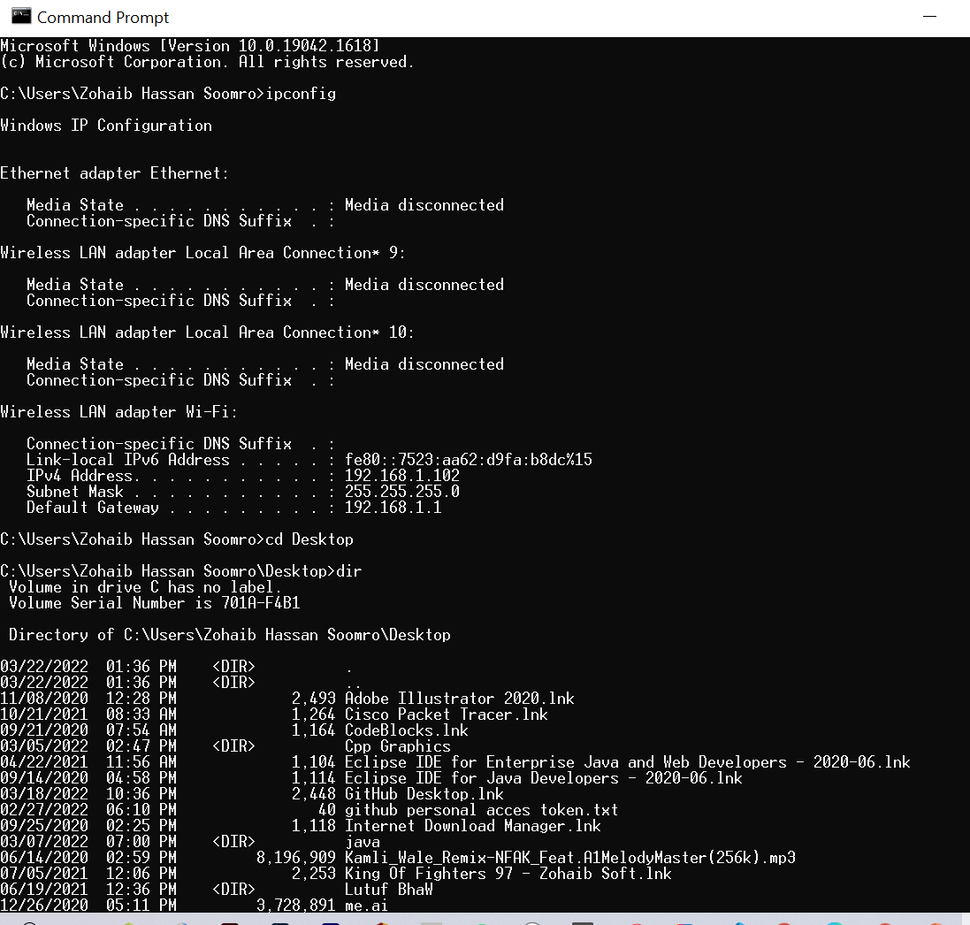

Slide 8
GRAPHICAL USER INTERFACE
Graphical user interface is sometimes shortened to GUI. The user chooses an option usually by pointing a mouse at an icon representing that option.
They are much easier to use for beginners.
They use a lot of memory and processing power. It can be slower to use than a command-line interface if you are an expert user.
They can be irritating to experienced users when simple tasks require a number of operations.

Slide 9
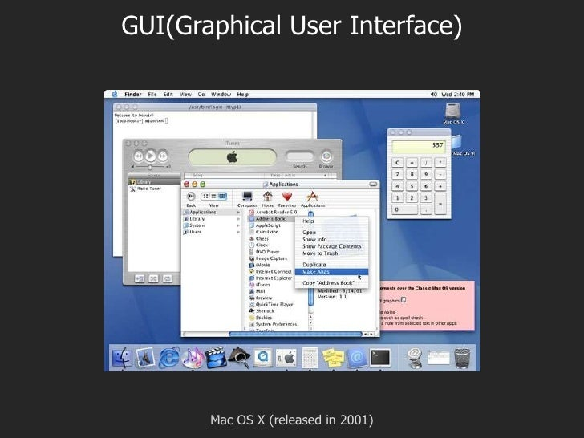
WINDOWS XP, WINDOWS VISTA, APPLE OSX AND UBUNTU ALL HAVE GRAPHICAL USER INTERFACES.

Slide 10
MENU SELECTION INTERFACES
Interface displays options as menu items for the user to choose from .
User indicates a choice and receives a feedback.
Menu Selection interface offers cues for user recognition.
Menus are to be effective; their names and icons are to be self-explanatory.
Easy for novice users to work on .
Too slow for expert users but this problem can be overcome by careful designing. (shortcuts..)

Slide 11
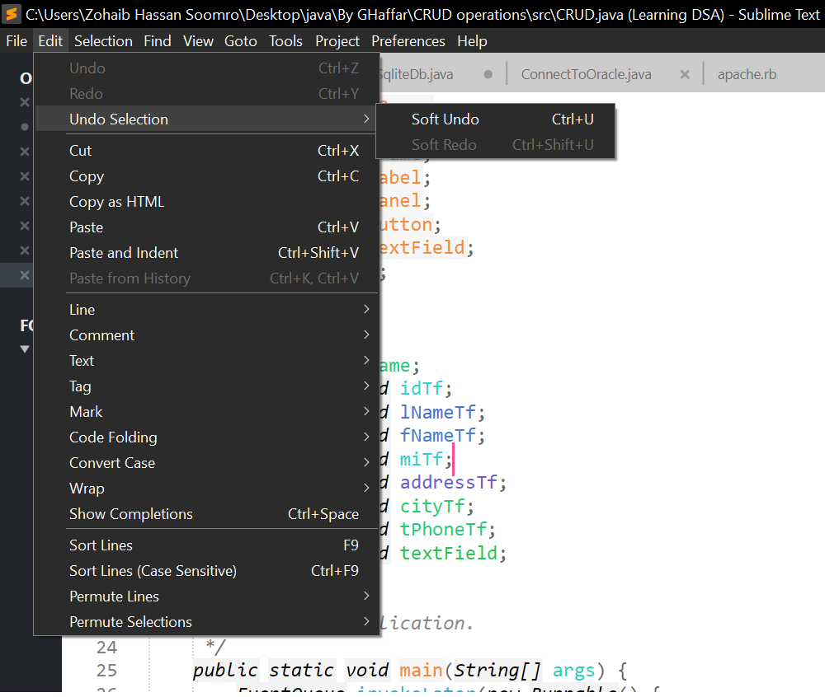

Slide 12
FORM-FILL INTERFACE
Applicable when a lot of information has to be gathered from the users.
A well-designed form-fill should have a predictable order of entering data into appropriate fields.
Should ensure easy movement and correction facilities.
A form-fill interface should be simplified by supplying default values for fields and allowing users to modify it if necessary.

Slide 13
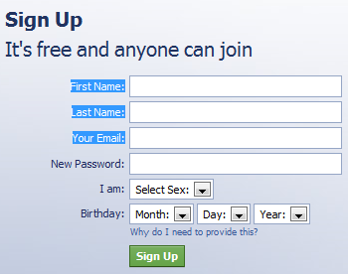
image reference: https://sites.google.com/site/userinterfaceswiki/form-fill-in

Slide 14
DIRECT MANIPULATION INTERFACES
Users directly interact with the UI objects.
Continuous input devices such as mouse, pen are used replacing command entries or menu choices.
DM interfaces exist in application areas such as in word processing, drag & drop tools, video games.

Slide 15
CHARACTERISTICS OF DM INTERFACES
Little syntax to remember.
Tasks are carried out by physical actions such as clicking, dragging….
Easy for novices to learn basic functionality.
Operations are rapid, incremental, reversible and immediately visible.
Feeling of interacting directly with the domain rather than with the interface.

Slide 16
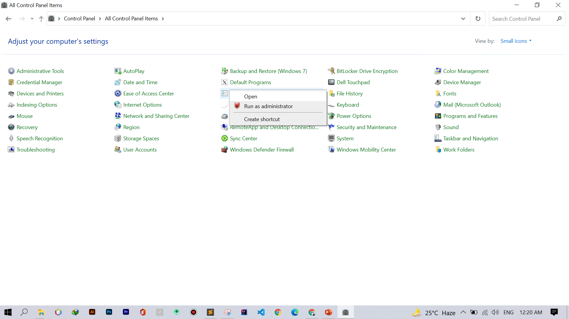

Slide 17
NATURAL LANGUAGE INTERFACES
Interfaces that recognize gestures, facial expressions, speech etc.
Understanding of human communication is necessary.
Handwriting, Typing are associated with problems of incorrect spelling, illegibility but overcome the problems of accent associated with speech.
A voice interface might need training to get the software to recognize what the user is saying.

Slide 18
NATURAL LANGUAGE INTERFACES
Promises flexible and easy communication with computers.
Users do not have to learn the syntax or principles of a particular language.
These interfaces are very expensive.
E.g : Siri, Alexa, Cortana or Google assistant that allows you to interact with your device using your own spoken language.

Slide 19
THANK YOU

